Slide 1

Blockchain + China Second-hand Car Study
2019 IDEO AUTOMOBILE MARKETING COMPETITION
TAO Yelan, SHI Haitian, LIN Li
2019.1.21

Slide 2
Two Questions
Are there any problems in China’s second-hand car market？What are the problems？
What is blockchain？What can it do？How？

Slide 3
Contents
Background of China Second-hand Car Market
Analysis of China Second-hand Car Business Model
China’s Second-hand Car Market Problems
What Can Blockchain Do?
What Should We Do with the Blockchain?

Slide 4


01
Background of China Second-hand Car Market
Economic and Political Background

Slide 5
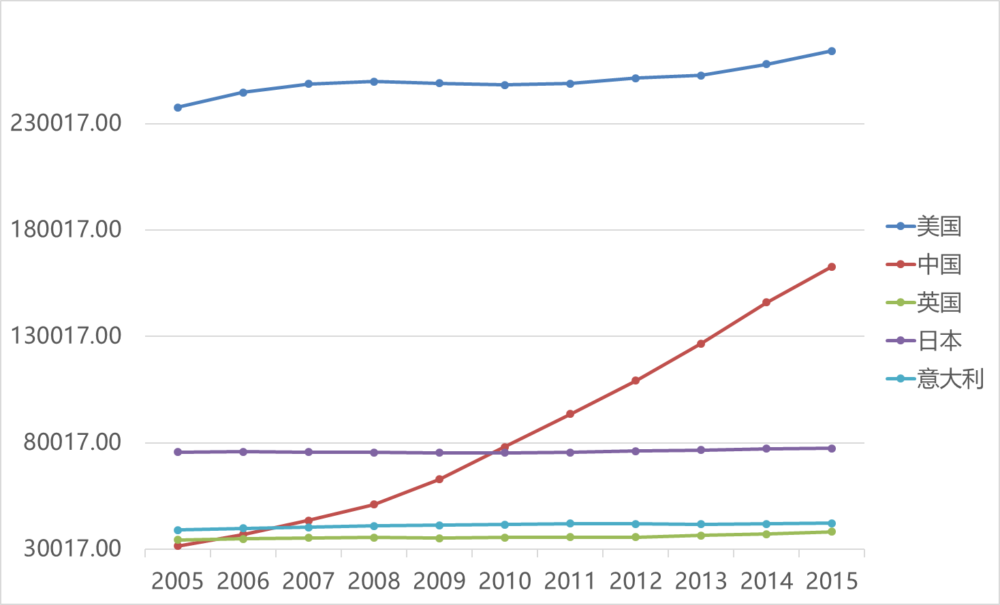
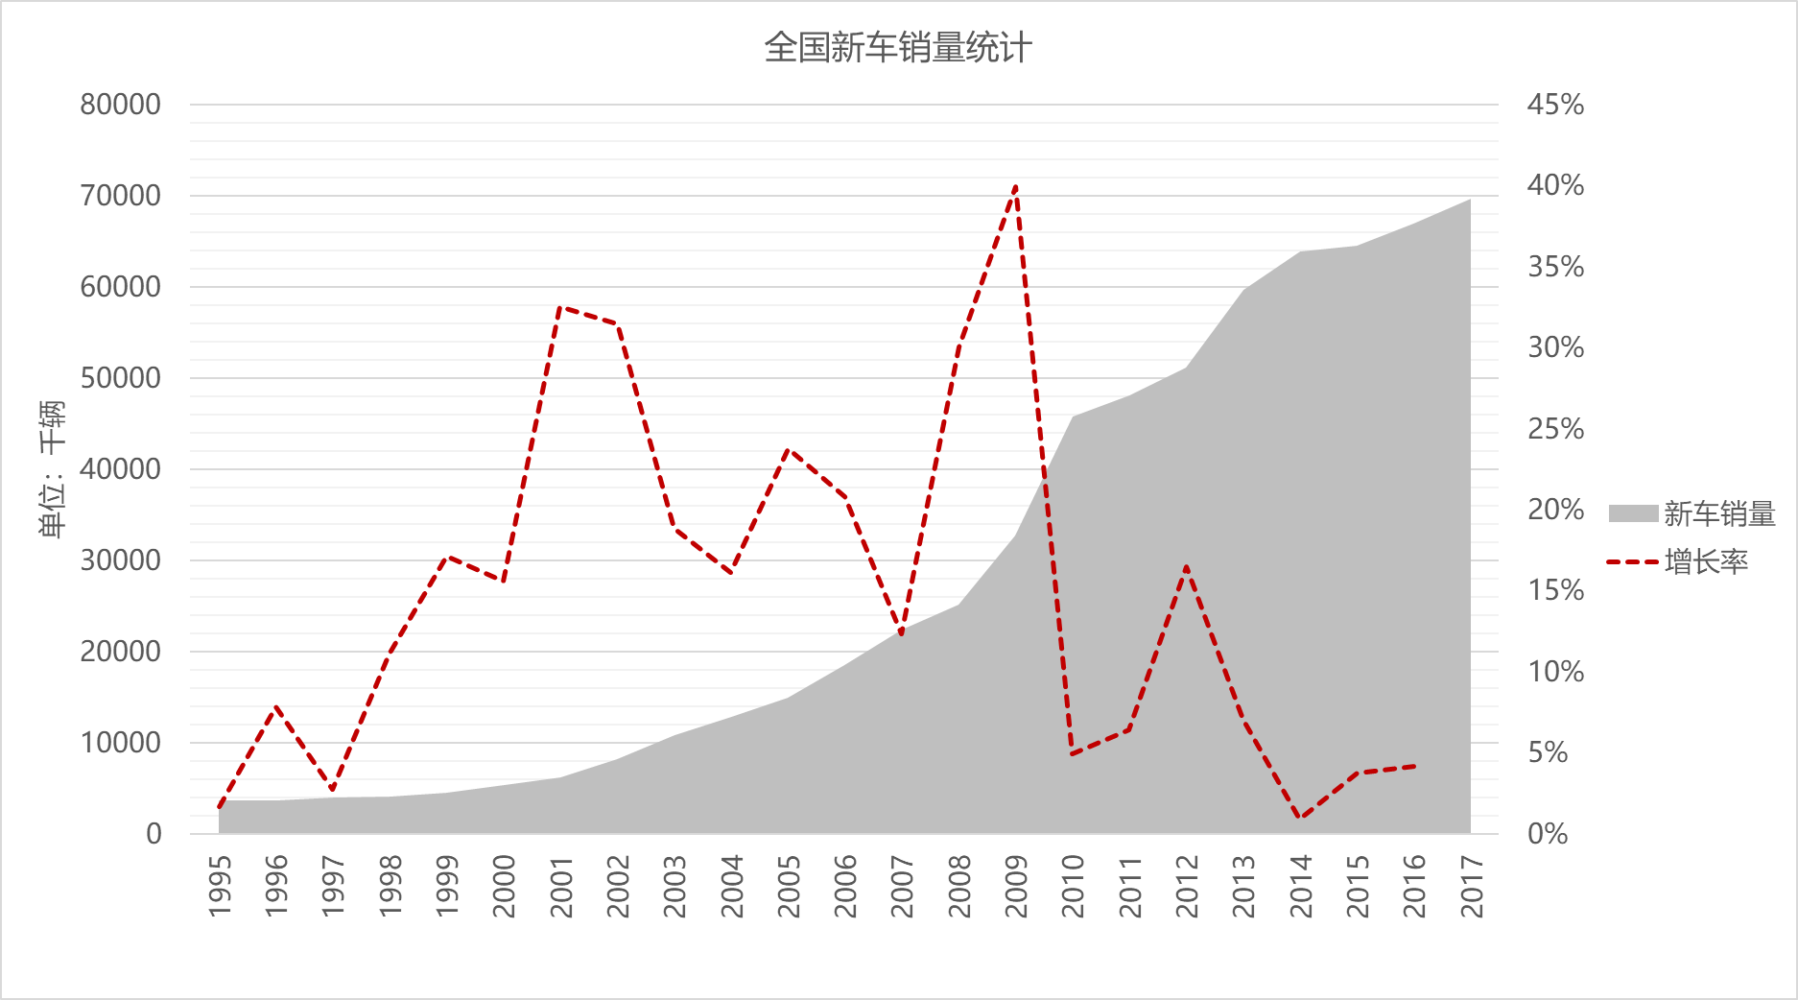
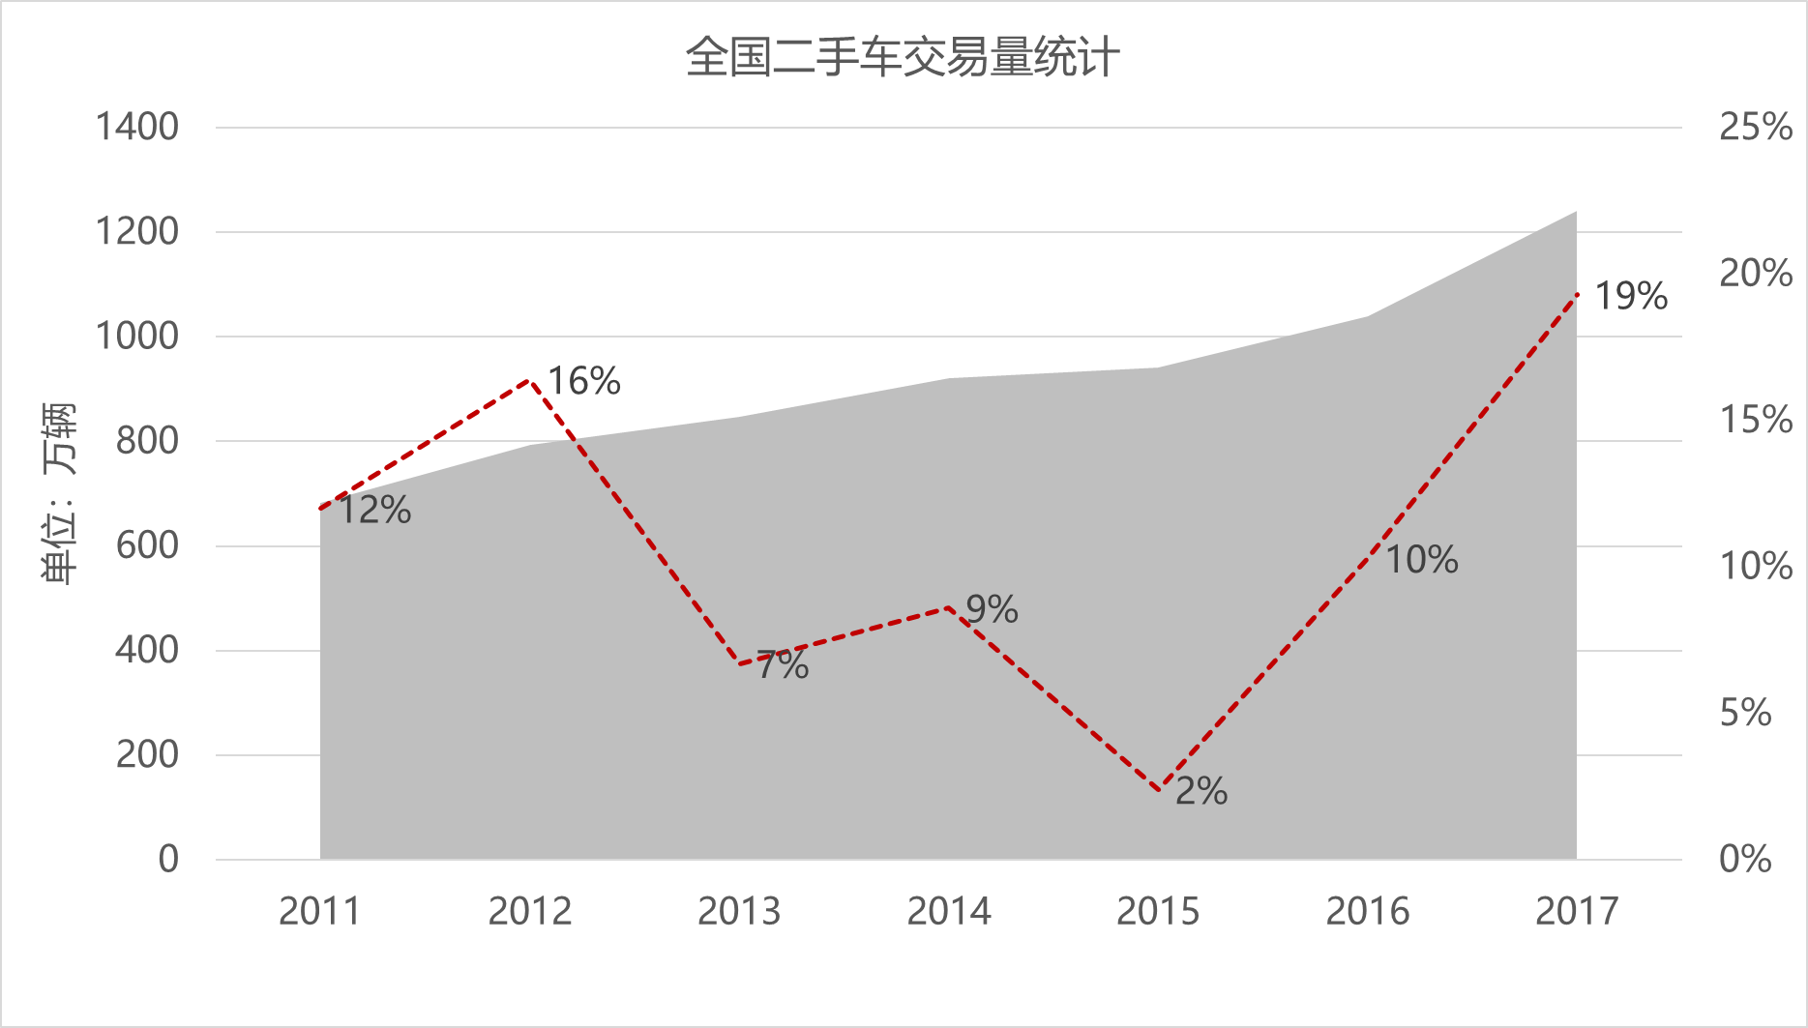
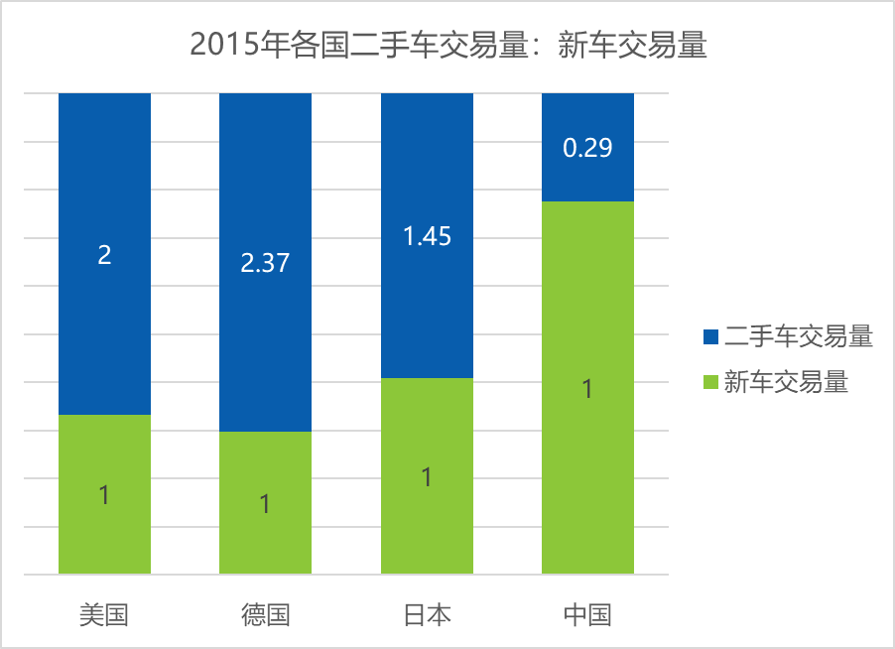
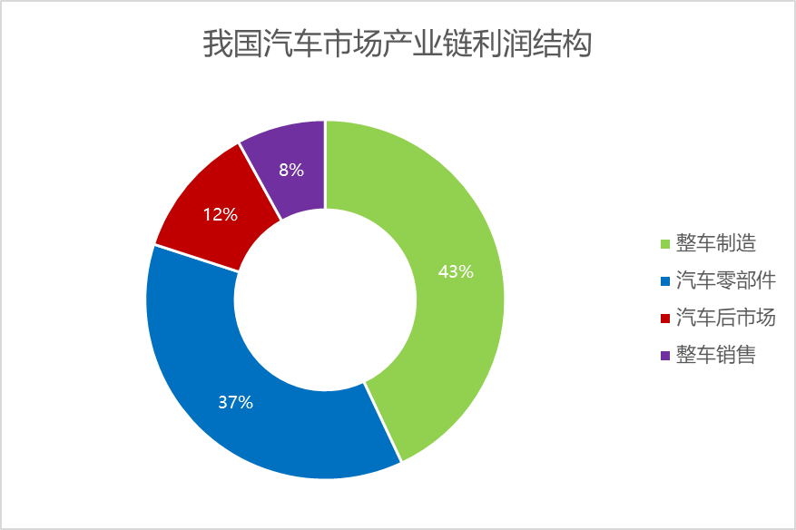
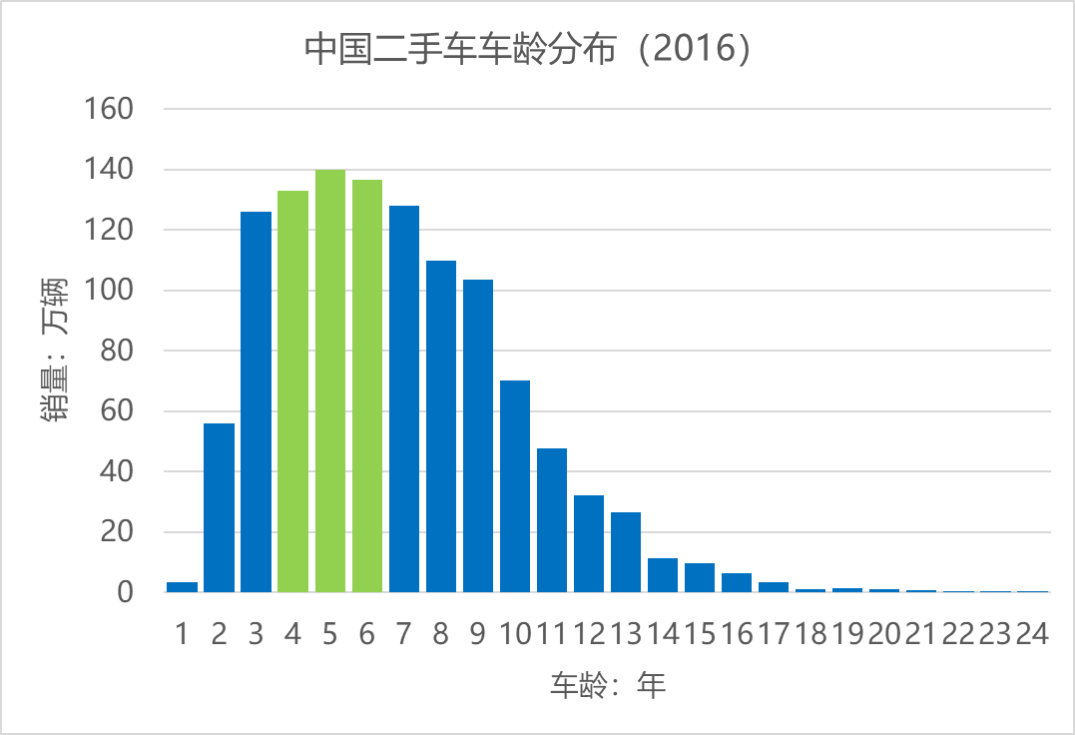
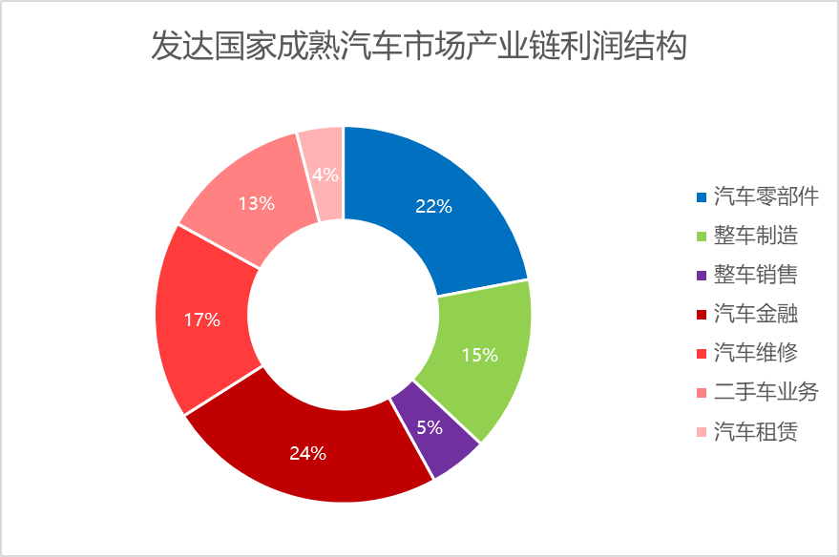
Economic Background
1. National car ownership continues to grow rapidly
2. Since 2013, new car sales have begun to shrink
3. Since 2015, second-hand car trading began to blowout
4. China's market is far from mature
5. China’s second-hand car market is about to break out

Slide 6

Economic Background
China’s second-hand car market is about to break out
The entire industry is on the eve of the outbreak
Market exploration period
Start-up period
Competition period
Shuffling period
Outbreak
period
In 2005, the Ministry of Commerce and the Ministry of Public Security jointly issued the "Measures for the Management of Used Vehicles Circulation", representing that the used car market has changed from a special industry management state to a market-oriented development. The form is still dominated by private operations, but there is a shift to intra-market transactions situation. The profit model is based on transaction service fees and venue rents.
Since 2013, Fengtou has been actively focusing on the used car market, and companies represented by Youxin and Che Yipai have successively obtained multiple rounds of investment. Financial industry companies such as Ping An Group and the SAIC Motor of the above-mentioned automobile group have launched safe and good cars and cars.
Youxin and Guazi were established, the industry‘s huge advertising war led the second-hand car market competition into a white-hot stage.
The market is the survival of the fittest, some excellent used car companies stand out, and the enterprises with large capital scale are laid out in the offline and new car, financial and other fields.
2005-2012
2012-2015
2015-2017
2017-2020
2020-

Slide 7
Political Background
National implementation of the lifting the restrictions on the second-hand vehicles (up to 2011.33.31)
Cancel the restriction policy
Reduce second-hand car loan restrictions
“Not open” means that all cities in the province still adopt a policy of restricting the move
“Partly open” refers to the lifting of the restrictions on certain cities in the province.
“Totally open” means that all cities in the province are allowed to move in vehicles that meet the minimum vehicle environmental protection and use standard. The above provinces and cities do not include the "three major regions"
Not open
Partly open
Totally open
The three major regions of Beijing-Tianjin-Hebei, the Yangtze River Delta and the Pearl River Delta (the eight regulations of the country) have not yet released the restrictions
来源：中国汽车流通协会
Notes:
“限迁”指某地区对于外省或者外市的二手机动车，采取限制环保标准、限制年份等措施准许上牌的行政行为

Slide 8
02
Status of China’s Second-hand Car Market

Slide 9
Unbalanced Supply and Demand
Uneven distribution of vehicle sources
First and second tier cities
The vehicle has a high output and flows to the cities of the third and fourth tiers and below.
third-tier cities
The vehicle is sold domestically and flows to cities in the fourth and lower cities.
四线及
以下城市
The output of the vehicle is very small, and it is sold domestically and to rural areas

Slide 10
Unbalanced Supply and Demand
2. Overall in the seller's market
When the team visited the second-hand car trading market in Huaxiang, Beijing, it was found that there were many foreign car dealers who came here to buy a car. After learning from the car dealers, they learned that they were attracted by Beijing’s rich second-hand car source and stable supply.
According to the general market rules, the early stage of the development of used cars, the supply of used cars is small, the overall market is the seller, and the source of the car is the best. For China, the sales of new cars in first-tier cities are large, the number of cars is large, and the sources of used cars are sufficient, but more cities are in short supply.
From the perspective of the industry as a whole, the seller's market will have a core problem: dealers have no incentive to shape brand value and user experience. From a consumer perspective, the market is still not perfect.
Site investigation
Analysis
Conclusion

Slide 11
Trading is not Standardized
Standard is not Complete
Pricing is not Reasonable
Private transactions
Illegal transactions
Buying used cars at low prices --> Selling at a higher price
Not paying the value-added tax
Deceiving consumers with shoddy cars
lacks the necessary industry norms and industry standards
Technical data not clearly defined
No uniform standard
Used cars not tested before being sold
Difficult to meet safety and environmental requirements
Consumer’s rights cannot be guaranteed.
The pricing system is not perfect
Lack of value assessment standards
Lack of residual value release system
Lack of management measures for identification and evaluation agencies
Pricing behavior is not standardized
The evaluators’professional level varies
Insufficient use of professional testing equipment
Lack of value assessment method (only depreciation method)

Slide 12




Low Level of Information
National used car information platform
China lacks mature platforms of this kind
The assessment is mainly carried out by the used car website. It provides the second-hand car evaluation and data service for buyers and sellers through the combination of “artificial intelligence + offline detection” vehicle credit and risk control system.
Carfax data is mainly from DMV and Police Department and several vehicle insurance companies.
Enter the brand, car, model, time of card, card area, mileage
Enter the vehicle VIN, the license plate where the vehicle is registered
Output vehicle estimated price
Output vehicle mileage/accident/maintenance record/airbag pop-up history, etc.

Slide 13
03
Analysis of China Second-hand Car Business Model

Slide 14
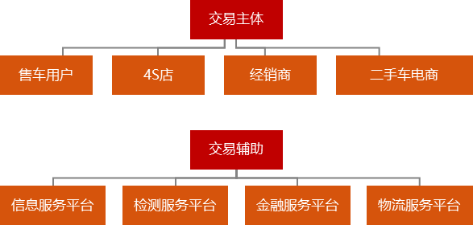
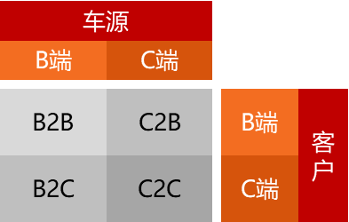
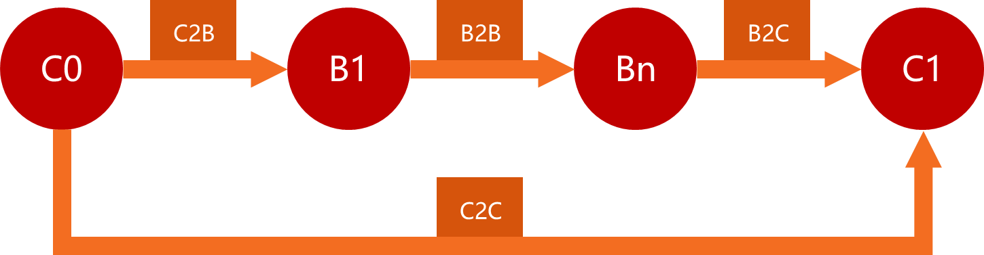
Analysis of Mainstream Business Models

Slide 15

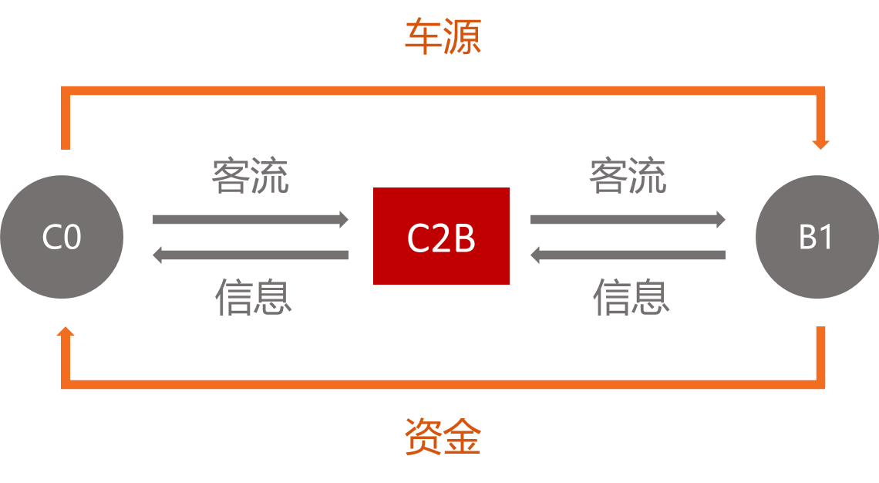
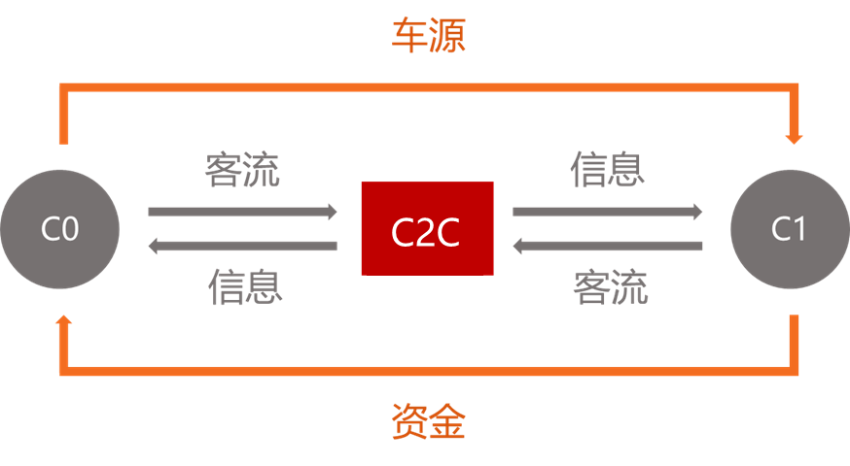
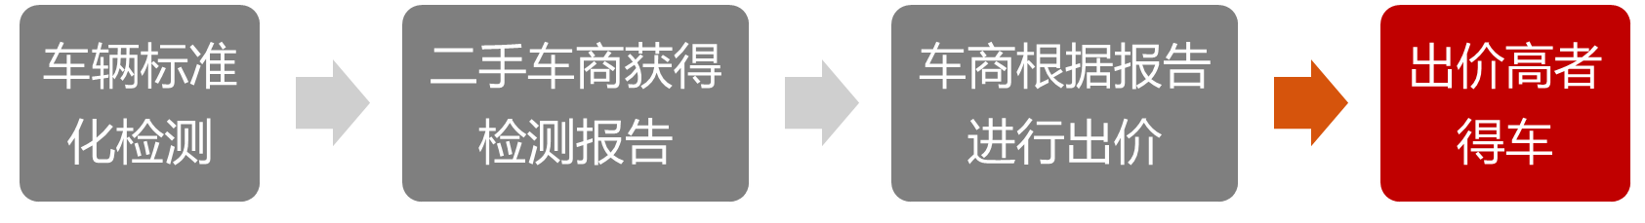
Analysis of Mainstream Business Models
B2B
C2B
C2C

Slide 16
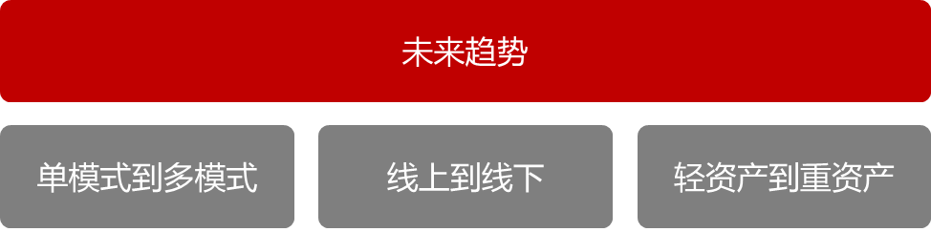
Analysis of Mainstream Business Models
Conclusion
The ultimate form of used car trading is the ideal C2C for car owners to consumers.
Due to the current shortage of vehicles and the immature after-sales guarantee system in China's used car market, used car transactions are inseparable from B2B, B2C, C2B and other modes for a long time.

Slide 17
04
China’s Second-hand Car Market Problems

Slide 18
Problem Analysis
Status Quo
Market
Market trading behavior is not standardized
Problem
Vehicle condition information system is not perfect
Transaction information asymmetry
Core of problem
The value assessment system is not mature
Price information asymmetry
Information asymetry
The market is still in the seller's market
Vehicle condition information asymmetry
Consumer
Lack of expertise
Lack of information channels

Slide 19
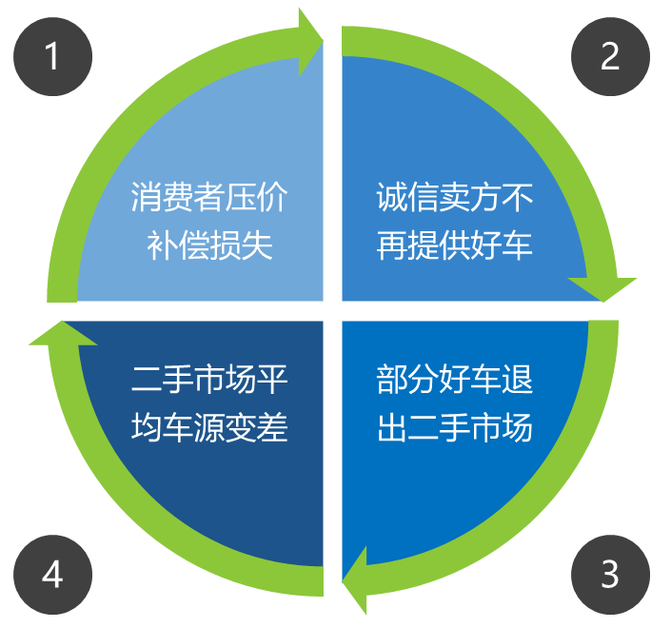
Problem Analysis - The Market for Lemons
Buyers & sellers' car condition information asymmetry
The used car market is shrinking
Some sellers profit from fraud
Consumers have a sense of distrust

Slide 20
05
What Can Blockchain Do?

Slide 21
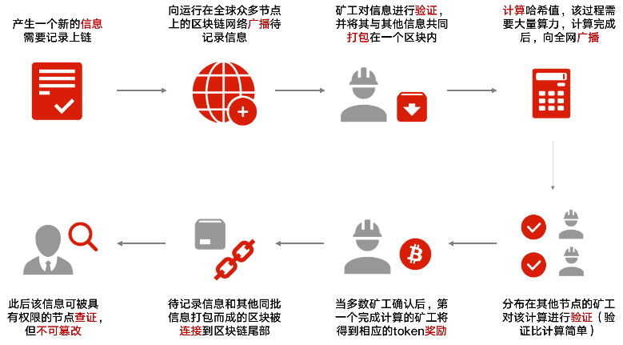
What is Blockchain
Characteristics
1) Decentralization
2) Trust
3) Collective maintenance
4) Reliable database
Structure
Basic network layer
Intermediate protocol layer
Application service layer

Slide 22
06
What Should We Do with the Blockchain?
Mileage fraud solution

Slide 23
Solution Background
China's used car market belongs to a typical "lemon market"
This is essentially the “honest car” in the market filling the trust loophole caused by the “tune-up car” by sacrificing its own transaction price. This is unfair to the majority of honest car owners in the market.
At present, there are no legal regulations directly related to the “adjustment of the odometer” in China.

Slide 24
Solution Description
Blockchain-based distributed mileage bookkeeping system "Innocent", which uses on-board IoT devices to periodically send the mileage of vehicles during car use, with the help of blockchain's non-tamperable features
When the owner sells the vehicle, he can use the chain record to effectively “self-certify the innocence” to ensure that the vehicle without the meter is rewarded as expected, and the consumer’s car purchase and car use process is more assured and indirectly suppressed the profitable space of the “adjustment” behavior.

Slide 25
Demand Analysis
Car owner
Most honest car owners lack proof of sufficient credibility to get the difference in the ideal car price
Car dealer
Second-hand car platforms or dealers have the need to build brand trust, the main quality and security, in order to successfully establish this brand image has to invest huge amounts of money in advertising, venues, packaging, etc.
Consumer
The above costs will eventually be added to the cost of the product, and consumers will pay for it, so consumers have an indirect need for such certification.
Others
In addition, used car finance companies, car insurance companies need to obtain lower cost vehicle data

Slide 26

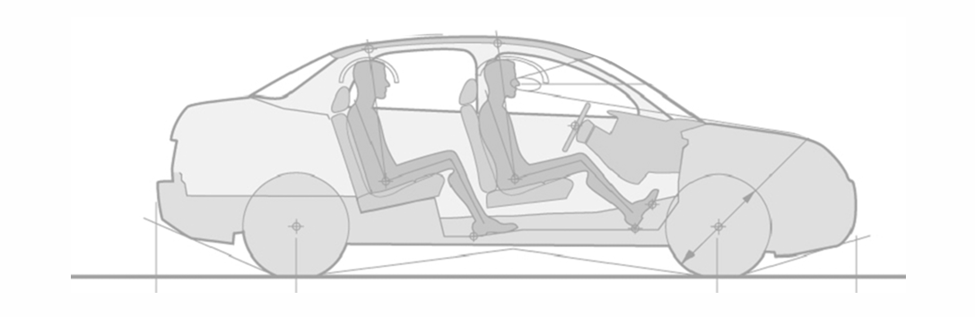

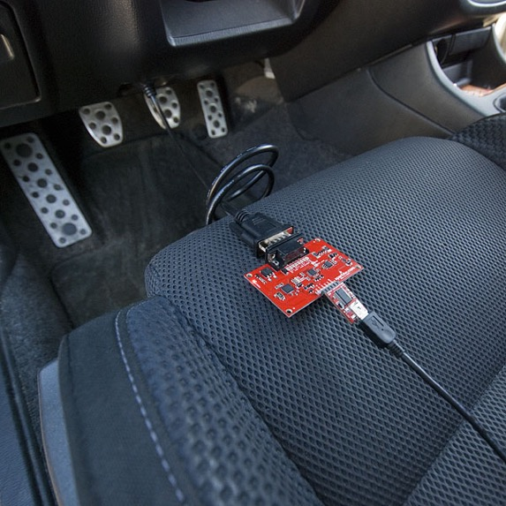
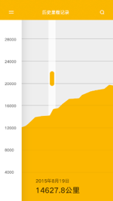
Principle of the scheme
Hash(Odometer1，GPS1，Date1，Nonce1)
Hash(Odometer2，GPS2，Date2，Nonce2)
该哈希值经过全网节点的运算后成功写入对应的区块链
C
SHA256哈希值
Hash(Odometer3，GPS3，Date3，Nonce3)
…….
加密后的数据包
“Innocent”数据库
SHA256
哈希值
D
收到数据包后储存在服务器上，提供数据分析和相关服务
以太坊应用
与其他车上传的哈希值一起经过分布式计算后写入区块链保存
基站
以太坊客户端自动执行上传和广播行为
A
芯片+发射器+GPS
“Innocent”本地应用
B
每隔t时间，从OBD读取一次里程数据并发送给绑定的手机
收到物联网模块发来的里程数据后进行哈希运算，并向云端发送加密信息
当前里程，GPS时间，位置坐标

Slide 27
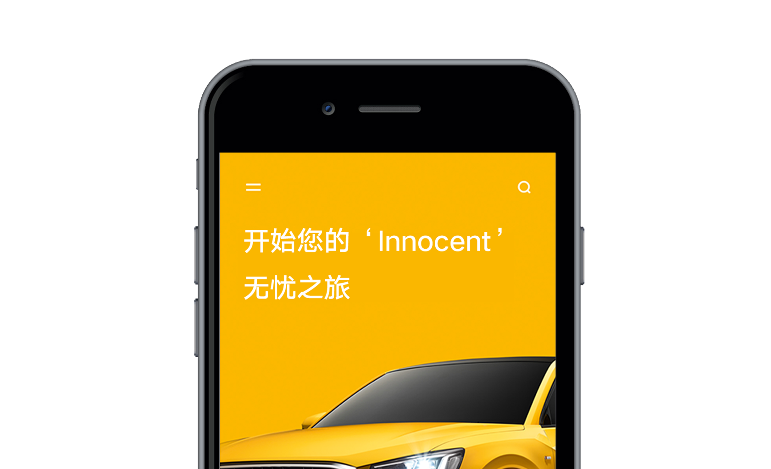

Innocent Mileage Verification
APP showcase

Slide 28

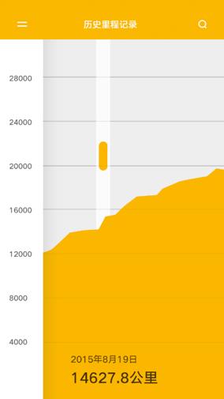
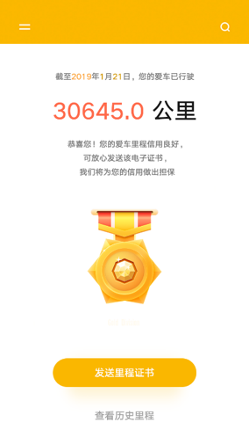
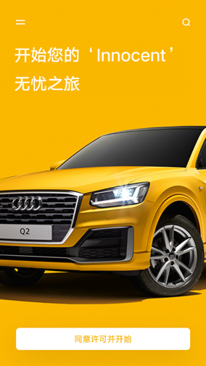
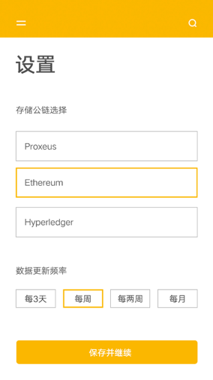
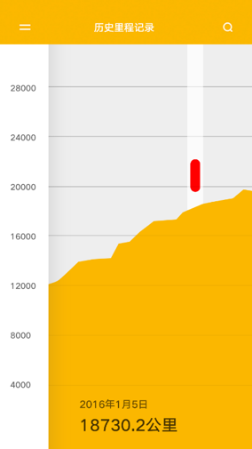

Raw data is resent to Innocent's cloud server
The company authenticates by comparing whether the hash value of the transmitted data matches the hash value on the blockchain.
If the certification is successful, the owner can check the certificate on the APP.
Certificates can be hosted online or sent to potential buyers via a link
View mileage record (normal)
Generate certificate (success)
Initiate the certification process
Set data synchronization options
View mileage record (abnormal)
Generate certificate (failure)

Slide 29
日期 | 时间 | 里程 | GPS读取
2015/8/19 | 15:00 | 14627 | $GPRMC,080655.00,A,4546.40891,N,12639.65641,E,1.045,328.42,170809,,,A*60
2015/8/22 | 16:00 | 14645 | $GPRMC,080655.00,A,4546.40891,N,12639.65641,E,1.045,328.42,170809,,,A*61
2015/8/25 | 17:00 | 14663 | $GPRMC,080655.00,A,4546.40891,N,12639.65641,E,1.045,328.42,170809,,,A*62
2015/8/28 | 18:00 | 14681 | $GPRMC,080655.00,A,4546.40891,N,12639.65641,E,1.045,328.42,170809,,,A*63
2015/8/31 | 19:00 | 14699 | $GPRMC,080655.00,A,4546.40891,N,12639.65641,E,1.045,328.42,170809,,,A*64
2015/9/3 | 20:00 | 14717 | $GPRMC,080655.00,A,4546.40891,N,12639.65641,E,1.045,328.42,170809,,,A*65
2015/9/6 | 21:00 | 14735 | $GPRMC,080655.00,A,4546.40891,N,12639.65641,E,1.045,328.42,170809,,,A*66
2015/9/9 | 22:00 | 14753 | $GPRMC,080655.00,A,4546.40891,N,12639.65641,E,1.045,328.42,170809,,,A*67
2015/9/12 | 23:00 | 14771 | $GPRMC,080655.00,A,4546.40891,N,12639.65641,E,1.045,328.42,170809,,,A*68
2015/9/15 | 0:00 | 14789 | $GPRMC,080655.00,A,4546.40891,N,12639.65641,E,1.045,328.42,170809,,,A*69
2015/9/18 | 1:00 | 14807 | $GPRMC,080655.00,A,4546.40891,N,12639.65641,E,1.045,328.42,170809,,,A*70
2015/9/21 | 2:00 | 14825 | $GPRMC,080655.00,A,4546.40891,N,12639.65641,E,1.045,328.42,170809,,,A*71
2015/9/24 | 3:00 | 14843 | $GPRMC,080655.00,A,4546.40891,N,12639.65641,E,1.045,328.42,170809,,,A*72
2015/9/27 | 4:00 | 14861 | $GPRMC,080655.00,A,4546.40891,N,12639.65641,E,1.045,328.42,170809,,,A*73
2015/9/30 | 5:00 | 14879 | $GPRMC,080655.00,A,4546.40891,N,12639.65641,E,1.045,328.42,170809,,,A*74
2015/10/3 | 6:00 | 14897 | $GPRMC,080655.00,A,4546.40891,N,12639.65641,E,1.045,328.42,170809,,,A*75
2015/10/6 | 7:00 | 14915 | $GPRMC,080655.00,A,4546.40891,N,12639.65641,E,1.045,328.42,170809,,,A*76
2015/10/9 | 8:00 | 14933 | $GPRMC,080655.00,A,4546.40891,N,12639.65641,E,1.045,328.42,170809,,,A*77

Slide 30
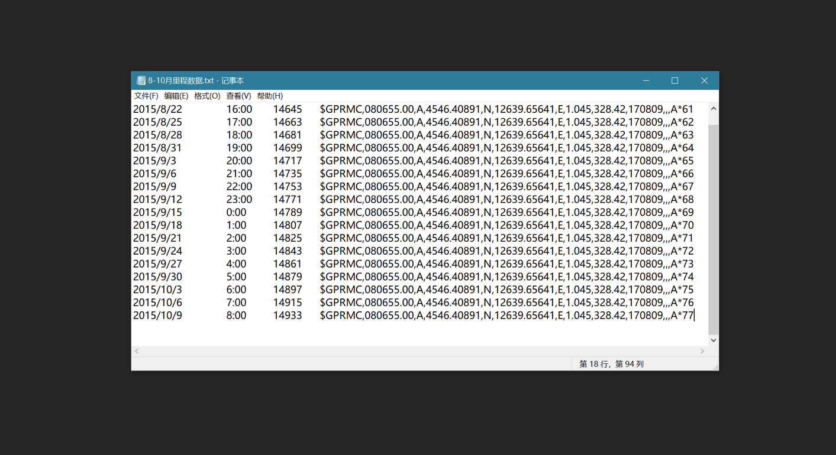
Hash运算
SHA256
5db442ba33a34d11fdeec341089514ff1d89b84984699f181a24472018d10fad
64
SHA512
85131300ec4ce4c4a962de5df1eedafa4ad1bf7803241ce6acd196d52af7a0b09c7fe71026fb529337d0d6a44222a8cef02675eec3ba75888e2ccf23ebd41894
128

Slide 31
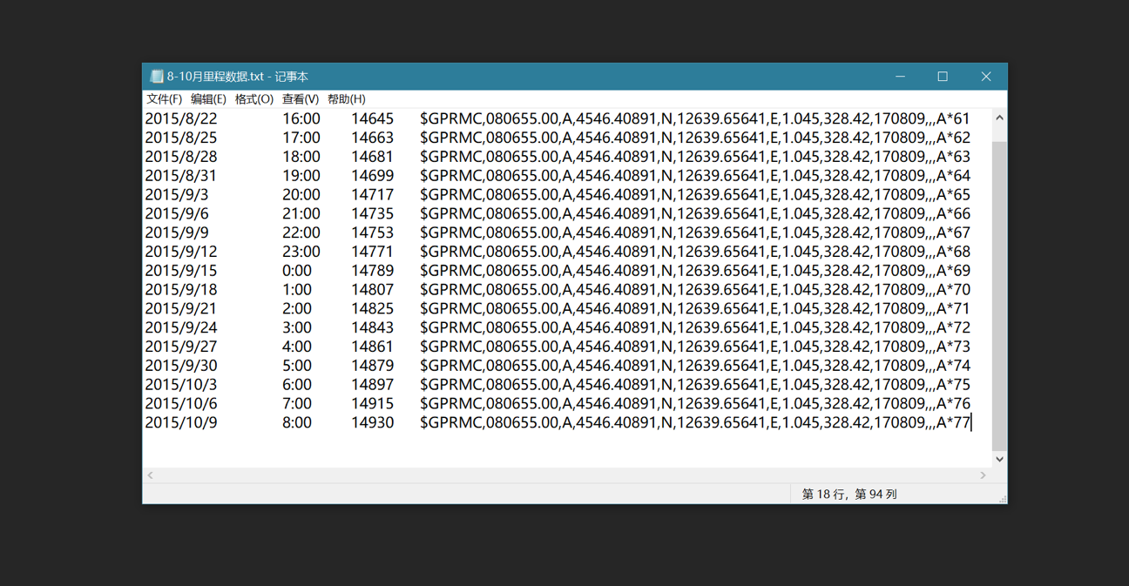
Hash运算
SHA256
21d2626af45d39f496043b3b2c4180e900ac3c111d026e7867594c1166d37458
64
SHA512
aeaea80fb2613d045e8d00805ee76d73dfcfa364d3ba689357fb6c1c8ec782097ba370073d7d88400bc5d4c303278a4ed8f133f68373596fc44200aed3ad4761
128

Slide 32
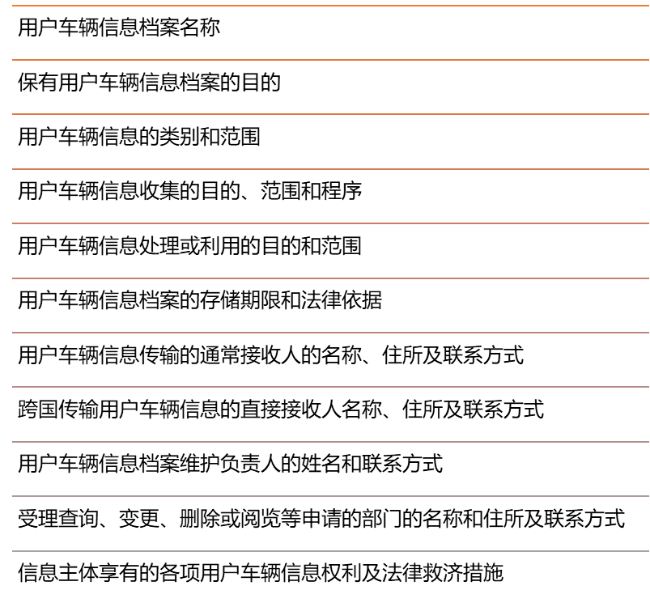
Solution feasibility
According to the "People's Republic of China Personal Information Protection Law", the second-hand car related information processing body,
User vehicle information can be collected and uploaded when the following conditions are met:
Obtained approval from the competent authority and registered with the registration authority for business qualifications and obtained a license
The right side of the announcement is posted on government announcements, local newspapers or other appropriate media:

Slide 33
Solution feasibility
When one of the conditions is met, the user's vehicle information can be collected and processed beyond a specific purpose:
The owner agrees or authorizes in writing
The contract with the owner or a similar contract does not harm the legitimate rights and interests of the owner.
When one of the conditions is met, the user's vehicle information can be utilized beyond the specific purpose:
To protect the public interest
To avoid the imminent danger of the owner or property of the car
Necessary to prevent major harm to the rights of others
The owner agrees or authorizes in writing
Fulfilling legal obligations
User vehicle information stored for user vehicle information protection inspection, user vehicle information security, and ensuring the normal operation of the user vehicle information processing equipment
It can be seen that as long as the relevant filing is carried out and the owner is authorized. Enterprises can legally use the blockchain to record the above information.

Slide 34
Solution limitations
Willingness to share
Safety problem
Cost problem

Slide 35
Further discussion
Operating costs are difficult to calculate accurately
Developed by a strong stakeholder company or alliance, such as a vehicle company alliance, an insurance company, and a used car head. To ensure the tolerance of the system's profitability.
Since the system itself makes the two sides of the used car transaction economically affordable, the profit space can be divided into a part for digital currency issuance, and each node is encouraged to perform distributed computing accounting.
The extensibility of the app.
As the technology matures, we can continue to design and develop the Internet of Things + blockchain system that covers engine maintenance records, accident records, transaction records, etc., and integrate these functions into one system and one chain to completely solve the problem of used car conditions. Symmetry issue.
In addition to IoT technology, it is also conceivable to obtain such records directly from the maintenance company/insurance company for winding.
Notes:
综上，我们提出的系统给了车主一个证明里程真实性的方法，需求切实存在，技术上可行，经济模型合理，符合我国相关的法律法规要求，一旦付诸实践，能够使多方收益，对二手车交易市场产生积极影响

Slide 36



Solution prospects
Used car digital identity system structure
Participation role
Consumer
Car owner
Car dealer
Car factory
Insurance company
Regulatory authority
Bank
Interface layer
Mobile APP
Initialization
Certification
Inquire
Supervision
Based on the Ethereum computing network, the application layer does not rely on independent Tokens to avoid ICO
Background layer
Member management module
Smart contract module
Block service module
Distributed storage system

Slide 37
Solution prospects
Basic Info | Brand, model, configuration, purchase time
Mileage | Mileage history and odometer issues
Test record | Appearance, interior, engine, etc.
Ownership history | Ownership record during the life of the vehicle
Service history | Vehicle maintenance and inspection records
Stolen situation | Whether the vehicle is a stolen vehicle
Attribution | Vehicle belongs to which provinces and cities
Recall situation | Public recall
Vehicle damage/accident history | Vehicle accident accident history

